Slide 1
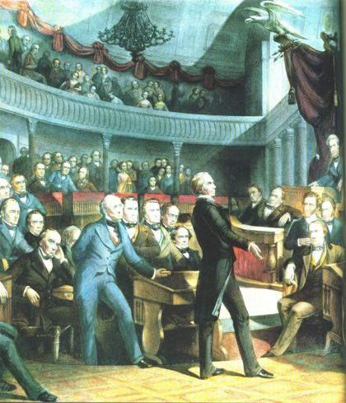
APUSH Review: The Compromise of 1850
Everything You Need to Know About The Compromise of 1850 To Succeed In APUSH

Slide 2
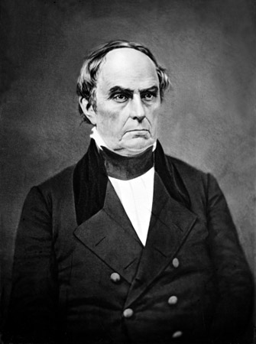
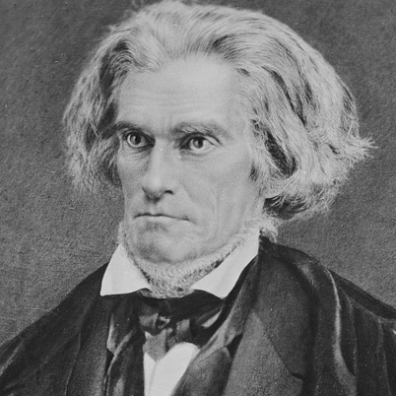
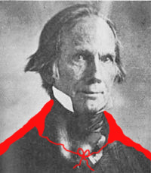
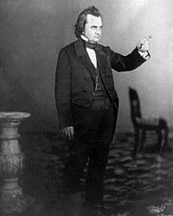
Key Players
Stephen Douglas:
Senator from IL, helped gain support for the Compromise
John C. Calhoun:
Senator from SC, wanted slavery to be left alone
Daniel Webster:
“7th of March Speech”
Called for North to support FSL and to compromise
Henry Clay!
Introduced the Compromise at age 72
What a champ!

Slide 3
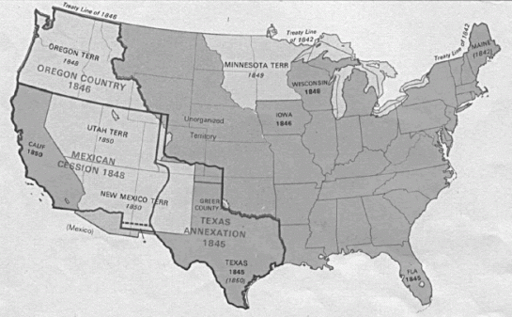
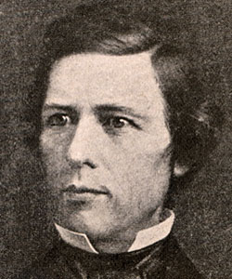
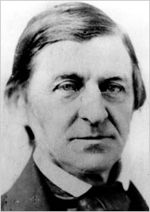
Background Info
Mexican-American War (1846 – 1848):
“Mexico will poison us” – Ralph Waldo Emerson
Treaty of Guadalupe Hidalgo
Wilmot Proviso:
If passed, slavery would have been prohibited from ALL land gained during Mexican-American War
Passed House, but not Senate
Texas claimed land east of Rio Grande, in present day New Mexico
Threatened war
South would come to aid of Texas if Texas was attacked

Slide 4
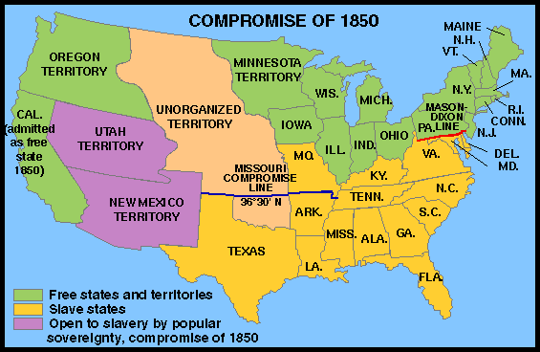

5 Parts
CA was added as a free state
Tips the balance in favor of free states
Slave Trade was abolished in DC
Slavery remained, just not the trade
Popular Sovereignty in land gained from Mexican Session
Those living in territories could decide status of slavery
More strict Fugitive Slave Act – will infuriate Northerners
Requires Northerners to aid in catching and return of slaves
Leads to Personal Liberty Laws
Texas paid $10 million to settle border dispute

Slide 5
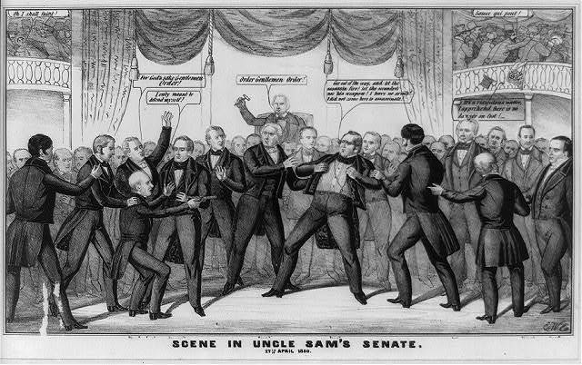
Impact of Compromise
Demonstrates tension in Congress – sign of things to come
Civil War was averted
North had more time to industrialize
Most Northerners did not support war in 1850
Many in the North move towards the abolitionist movement
Personal Liberty Laws are not enforced in the North
Essentially nullification
“Let the assassin fire!”

Slide 6
Past Essay Topics
Analyze the effectiveness of political compromise in reducing sectional tensions in the period 1820 to 1861. (2004 Free Response)
In the early nineteenth century, Americans sought to resolve their political disputes through compromise, yet by 1860 this no longer seemed possible. Analyze the reasons for this change. Use the documents and your knowledge of the period 1820-1860 in constructing your response. (2005 Form B DBQ)
Analyze how western expansion contributed to growing sectional tensions between the North and the South. Confine your answer to the period from 1800 to 1850. (2012 Free Response)

Slide 7

Thanks for watching!
Subscribe to my channel
Help spread the word
Questions? Comments? Ideas for videos?
Leave in comments
“Let him subscribe!”
Subscribe
Down here!

